Slide 1

Touch the sky, turn the page
A wake up and warm up exercise
Don’t watch me,
Do what I say

Slide 2

Touch the sky

Slide 3
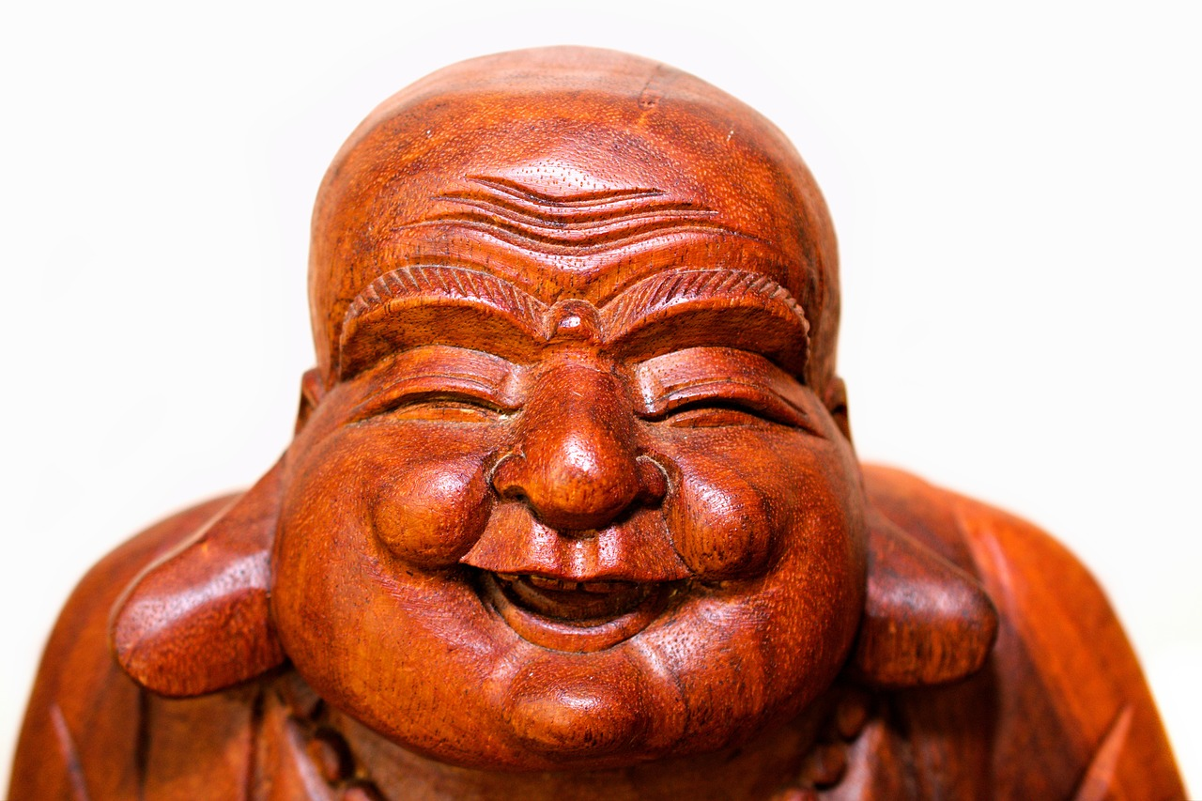
Touch your head

Slide 4
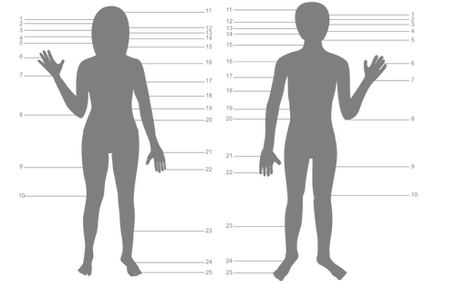
Touch your shoulder

Slide 5
How’s the weather?

Slide 6
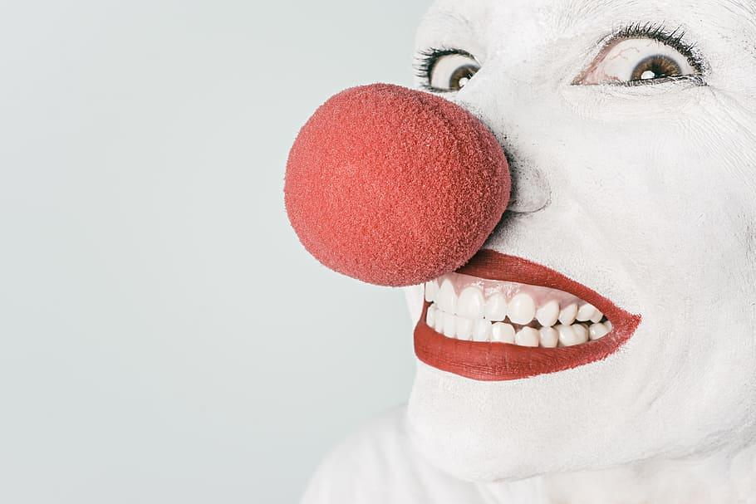
Touch your nose

Slide 7

Touch your ears

Slide 8
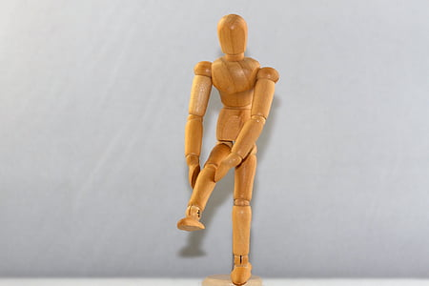
Touch your Knees

Slide 9

Touch your toes

Slide 11
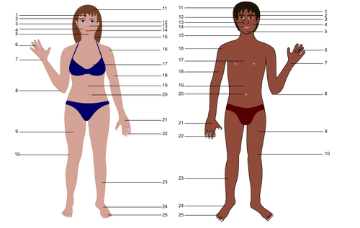
Touch your shoulder

Slide 12
WHAT DAY IS IT TODAY?

Slide 14


Slide 15

Touch your Textbook

Slide 16
Touch your Nose

Slide 17
Touch the sky

Slide 18
Touch your ears

Slide 20
WHAT’S the DATE ?

Slide 21
Touch the Sky

Slide 24
Touch your toes

Slide 25
Touch the sky

Slide 26
Touch your shoulders

Slide 27
Touch your Desk

Slide 28
TOUCH YOUR CHAIR

Slide 29
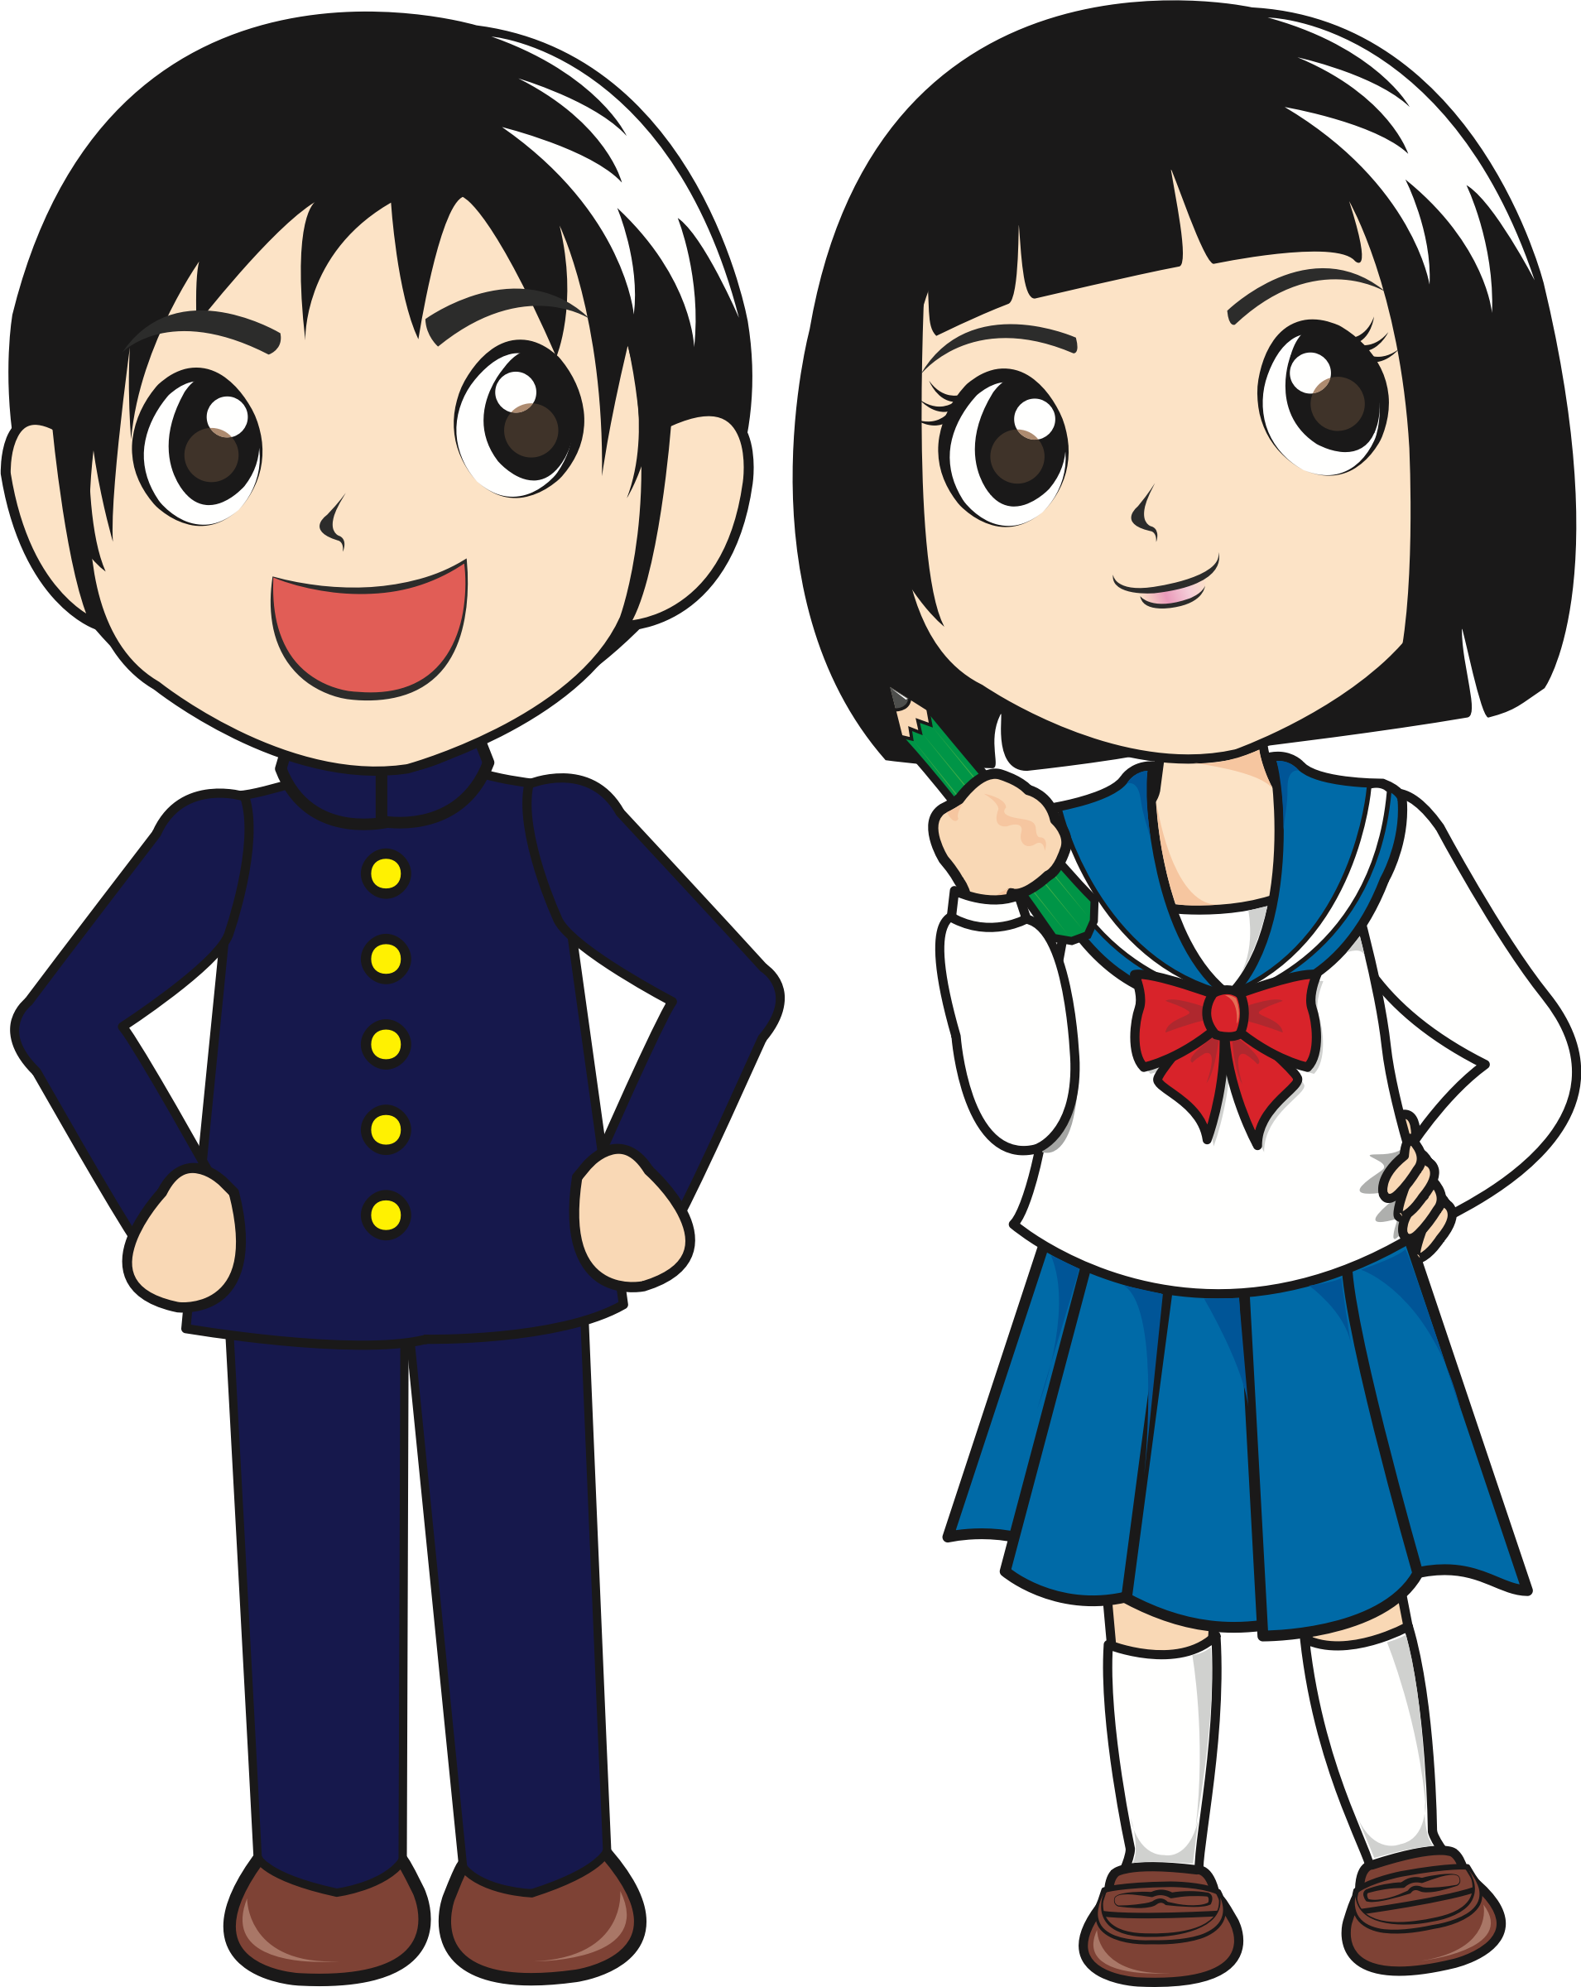
say Hello to your friends

Slide 30
GAME OVER?
OPEN your Textbook
To page 137
Page 137

